Slide 1
Data Poor Research

Slide 2

Professional Experience + Education
  Professor of Earth + Environmental Sciences, Columbia
    Previously Professor of Atmospheric + Oceanic Science, Wisconsin
  PhD, Climate Physics + Chemistry, MIT
Expertise
  Ocean carbon cycle, feedbacks with climate
  Ocean and climate modeling
  Data science
Synergistic Activities
  The Oceanography Society, Councilor, 2020-present
  JASON Advisory Group, 2015-present
  Diversity Committee chair, EES department, 2019-present
  Co-chair for undergrad education, Wisconsin AOS, 2010-15
2

Slide 3

Professor + Chair of Statistics, Columbia
PhD, Statistics, Columbia
Expertise
  Spatiotemporal modeling
  Statistical machine learning
  Data science education
  Management
Synergistic Experience
  Associate Director for Education,
  Data Science Institute (DSI), 2017-2020
  Creator, DSI Scholars Program, 2018-2020
  Leadership Team Member, Collaboratory Program
  Faculty Advisor, Columbia Statistics Club 2016-2020
3

Slide 4

Implementing our vision
LEAP forward in the reliability, utility, and reach of climate projections through synergistic innovations in data science and climate science.

Slide 5
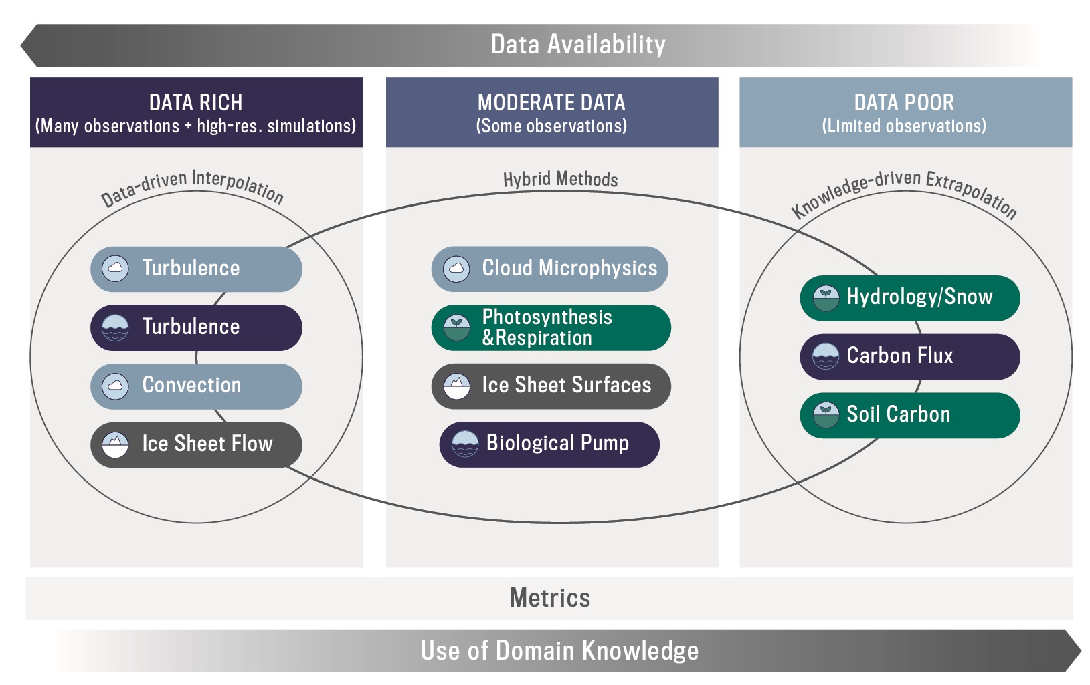

Understanding complex systems is often complicated by a lack of data: “Data Poor”
Physics Guided ML
  Hydrology and Snow
ML-based data products w/ uncertainty
  Air-sea CO₂ Flux
  Soil Carbon
5

Slide 6
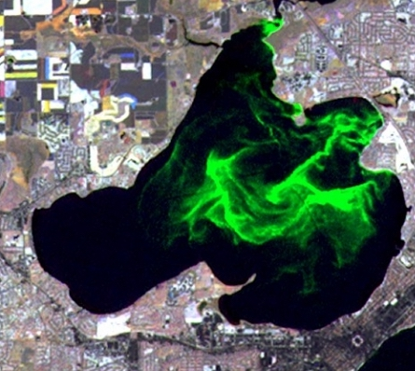
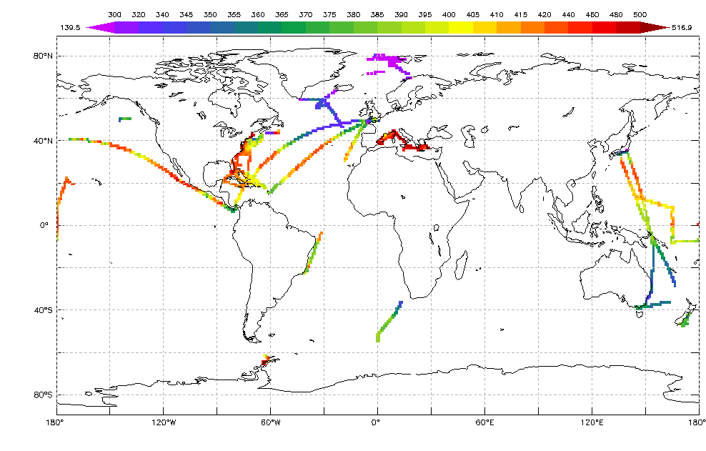
Understanding complex systems is often complicated by a lack of data: “Data Poor”
Inland lake – PGML Example
Physics Guided ML
  Hydrology and Snow
ML-based data products w/ uncertainty
  Air-sea CO₂ Flux
  Soil Carbon
6

Slide 7
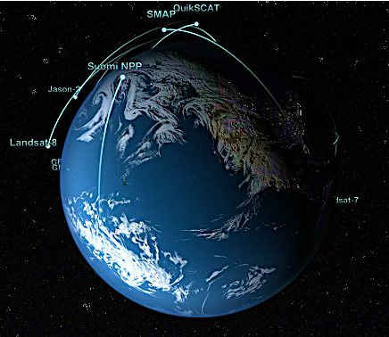
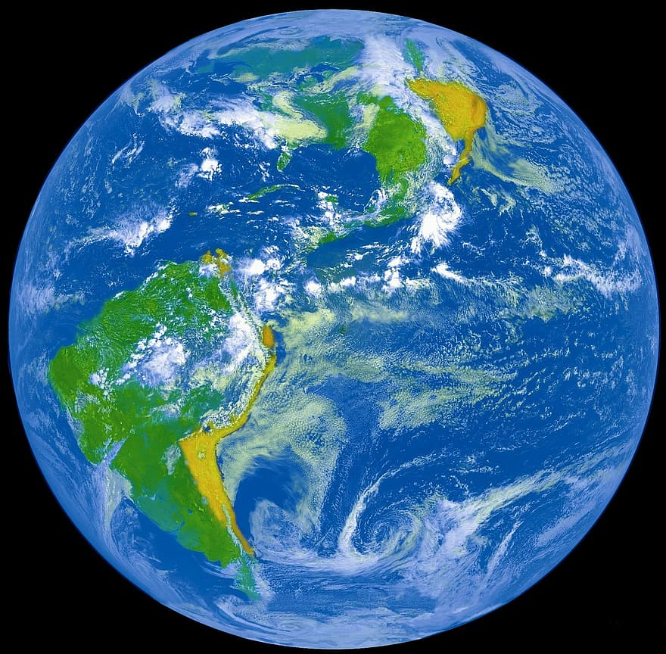
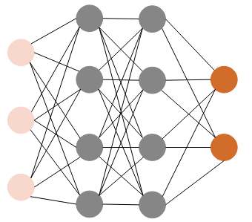
Challenges | Opportunities
Advanced observing systems and
new infrastructures to link datasets
Sparse Data
Advances in machine learning
Deep Learning, Physics-Guided ML,
Modeling of Functional Objects
Complex Processes
Advances in optimization
and cloud computing
Computational Intensity
7

Slide 8
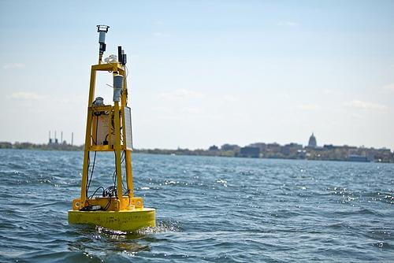
Understanding complex systems is often complicated by a lack of data: “Data Poor”
Inland lake – PGML Example
Physics Guided ML
  Hydrology and Snow
ML-based data products w/ uncertainty
  Air-sea CO₂ Flux
  Soil Carbon
8

Slide 9
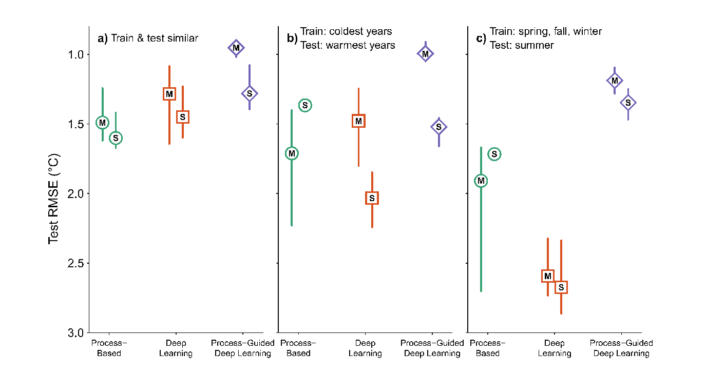
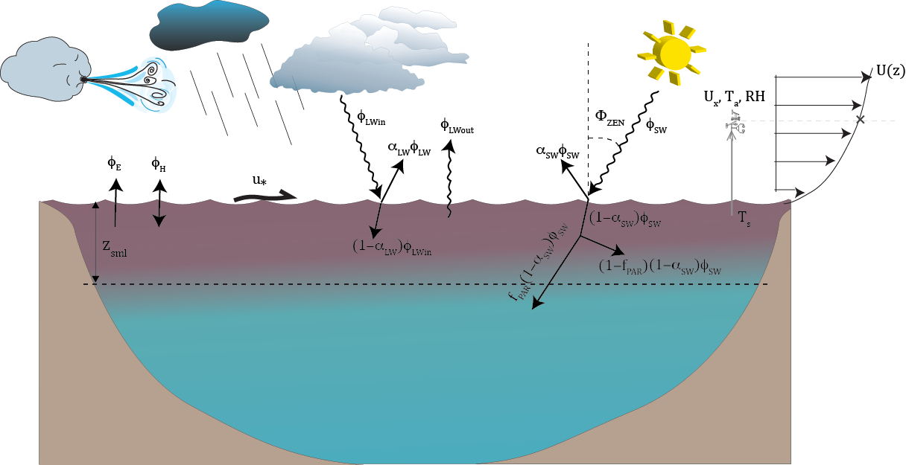
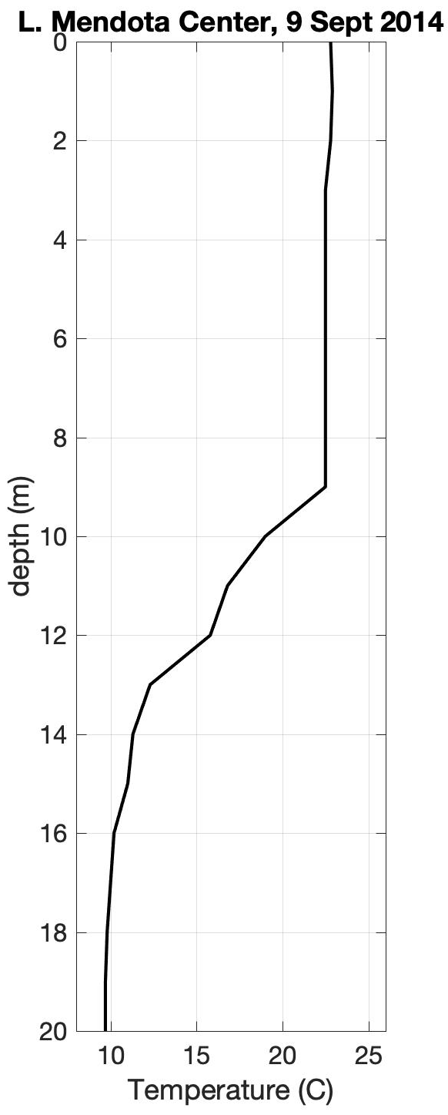
Status Quo: Process model to predict lake 1D temperatures
Results
Lake Mendota, WI
Process Model for 1D lake hydrodynamics
Train, Test similar
Can ML improve predictions?
Better fit to independent data
Read, Kumar et al. 2019, Water Resour. Res.
9

Slide 10
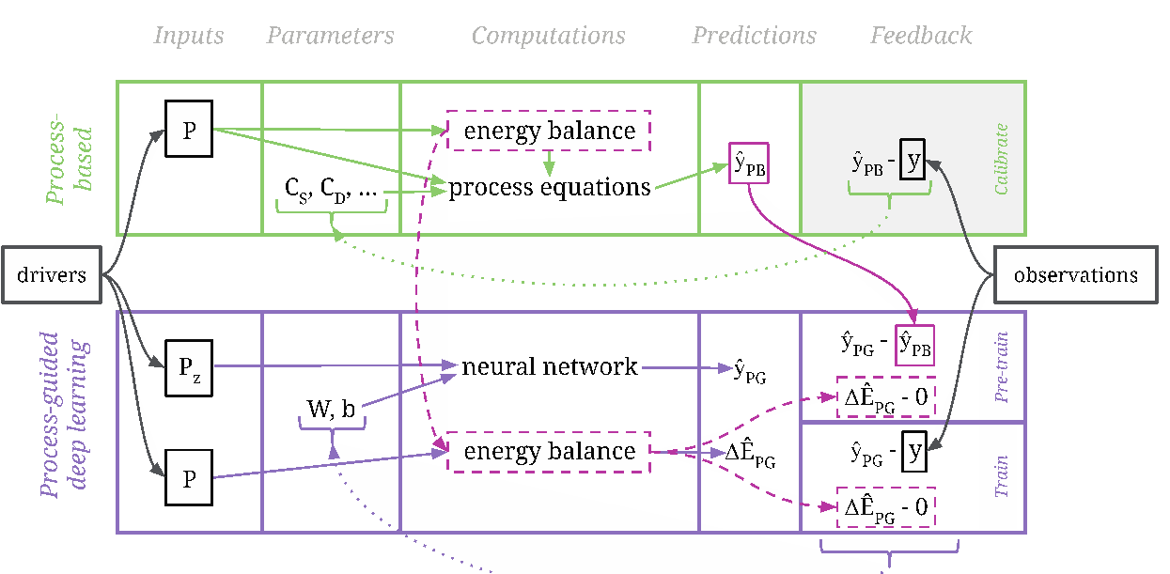
Physics-Guided ML blends process knowledge and deep learning for more robust predictions
Lake Mendota, WI
Train, Test similar
Train: fall, winter, spring
Test: summer
use deep learning alone
add stability constraint to DL
Better fit to independent data
(1) (2)
(1) (2)
Read, Kumar et al. 2019, Water Resour. Res.
10

Slide 11
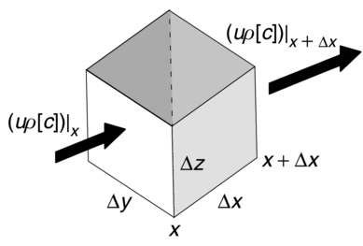
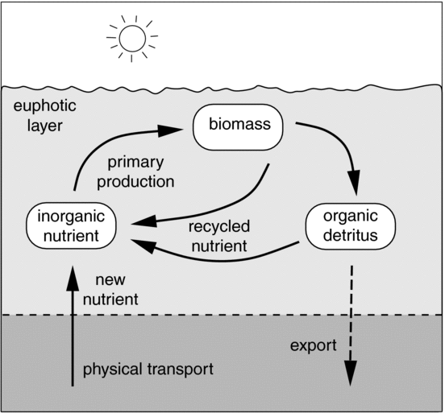
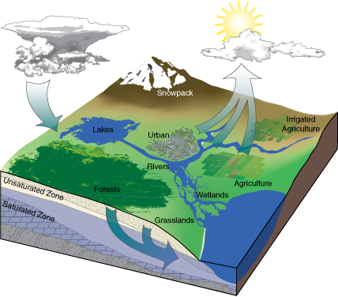
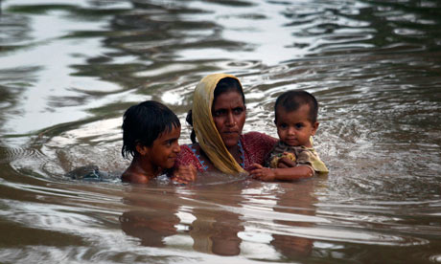
Next step: extend Physics-Guided ML to multiple interacting processes and spatial scales
3D physics
Ecology
1-D physics only
Global hydrology: Yang, Gentine et al. 2019, ERL
11

Slide 12
Understanding complex systems is often complicated by a lack of data: “Data Poor”
Physics Guided ML
  Hydrology and Snow
ML-based data products w/ uncertainty
  Air-sea CO₂ Flux
  Soil Carbon
12

Slide 13
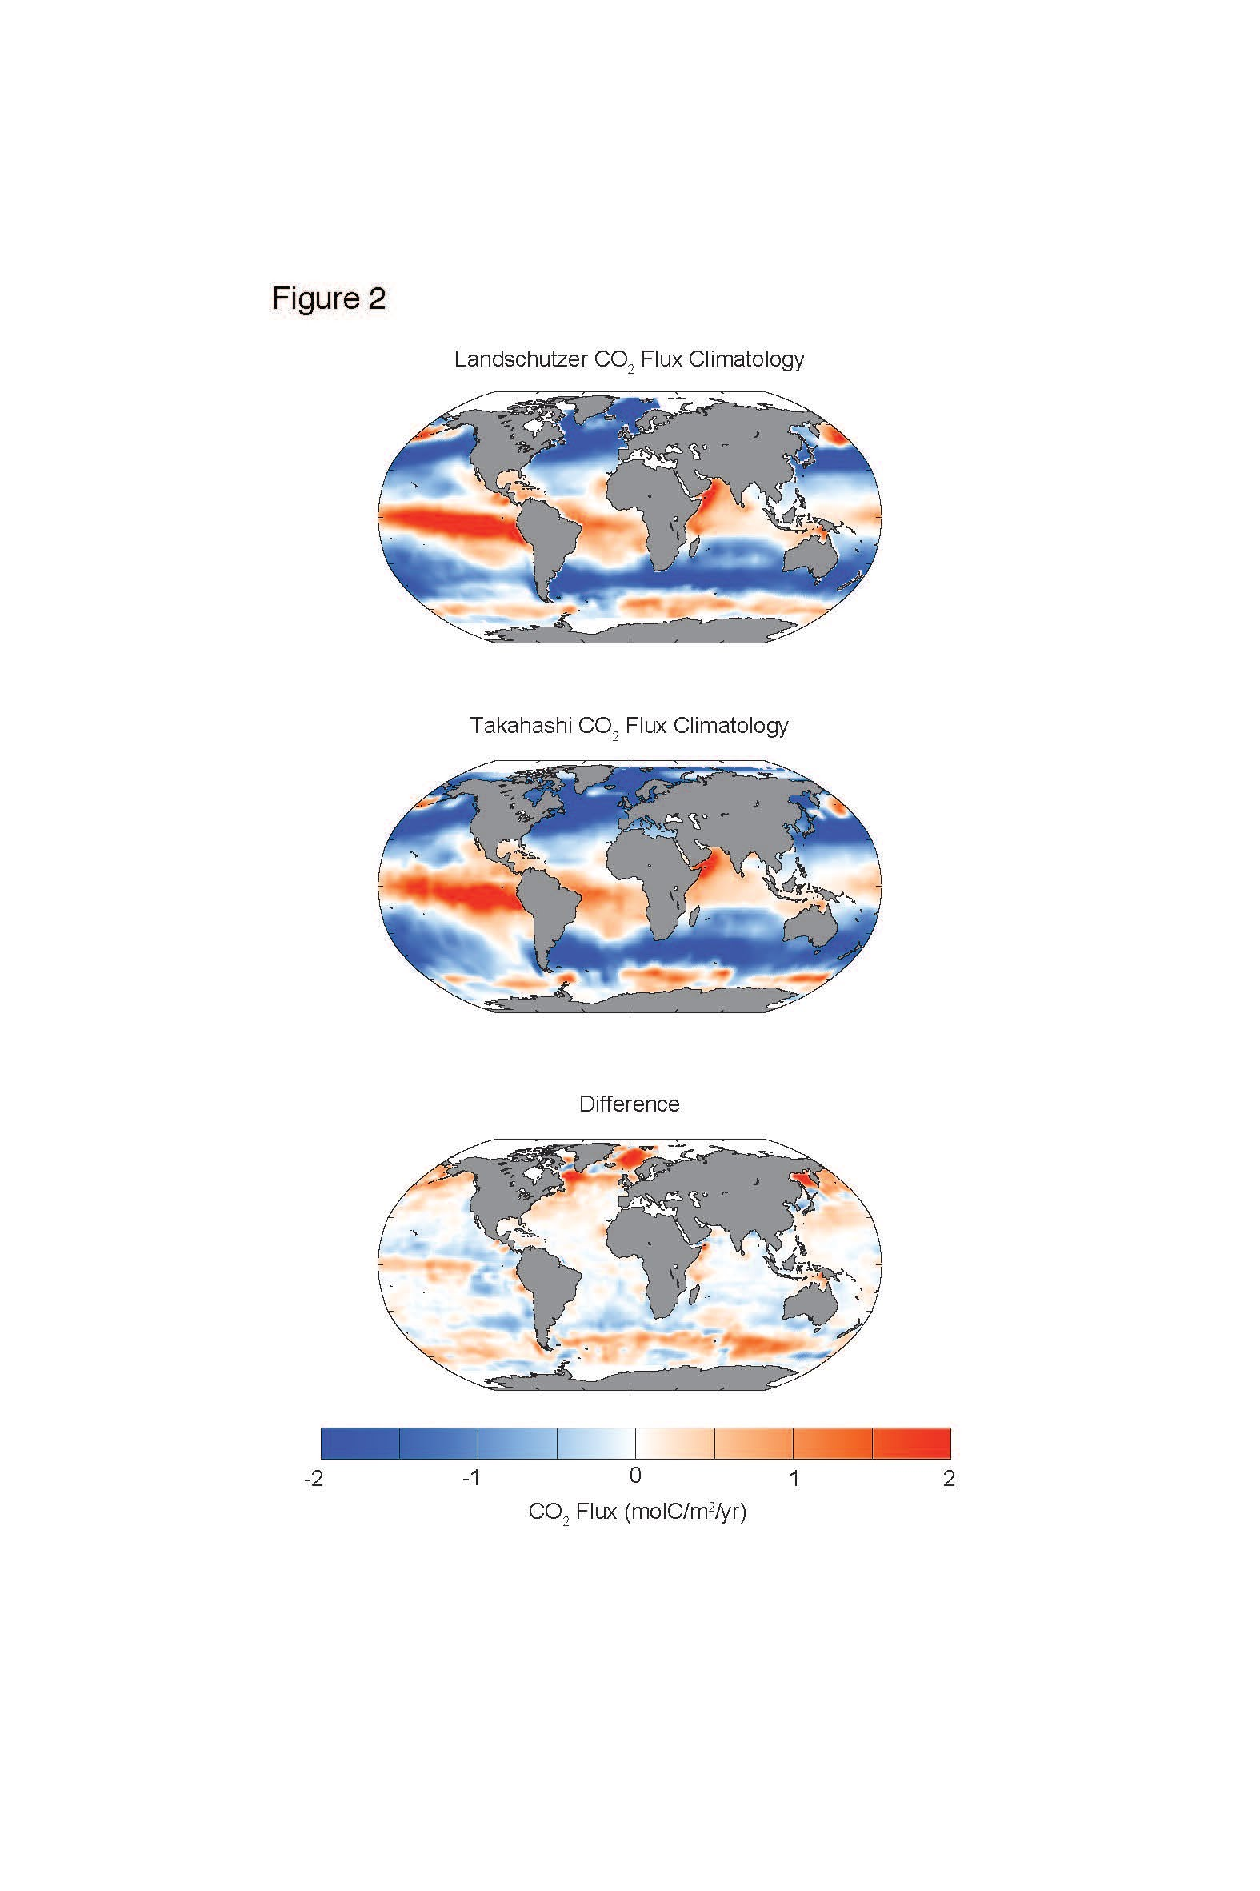
Status Quo: Apply existing ML to extrapolate
1. Train an off-the-shelf Neural Network
SST
SST
Temp
SSS
SSS
Salt
pCO₂
MLD
pCO₂
MLD
Depth_{mix}
pCO₂ June 2016
Chl
Chlorophyll
How are the uncertainties structured?
pCO₂^{atm}
2. Predict pCO₂ everywhere
3. Calculate CO₂ flux
Landschutzer et al.(2014), GBC
13

Slide 14
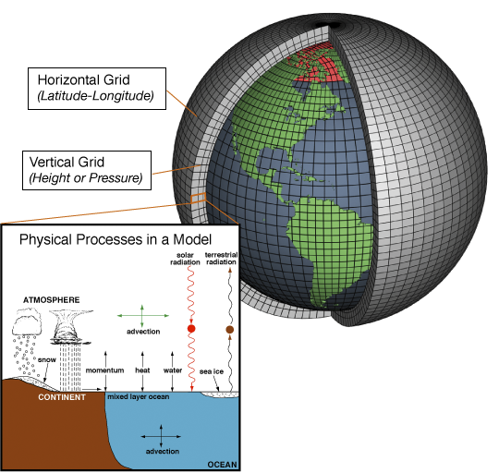
Earth System Models provide ample simulated data with which ML uncertainties can be evaluated
Ocean pCO₂ model output
4 Large Ensembles (CESM, CanESM, GFDL, MPI)
25 members x 4 = 100 members
1985-2016
14

Slide 15
Using ESMs to test skill of ML extrapolation
CESM 002
x100 members
1. Sample model member as SOCAT monthly pCO₂ product
4. Statistically compare reconstructed CO₂ flux to model truth. Each spatial point is temporally decomposed
2. Train, evaluate, test reconstruction method at sampled locations
3. Estimate monthly varying pCO₂ on global scale using trained model, calculate flux
Apply Machine Learning Algorithms
Neural Network
eXtreme Gradient Boost
Random Forest
x100 members
Gloege, McKinley et al. in review
Stammel, McKinley et al. in review
reconstruction
15

Slide 16
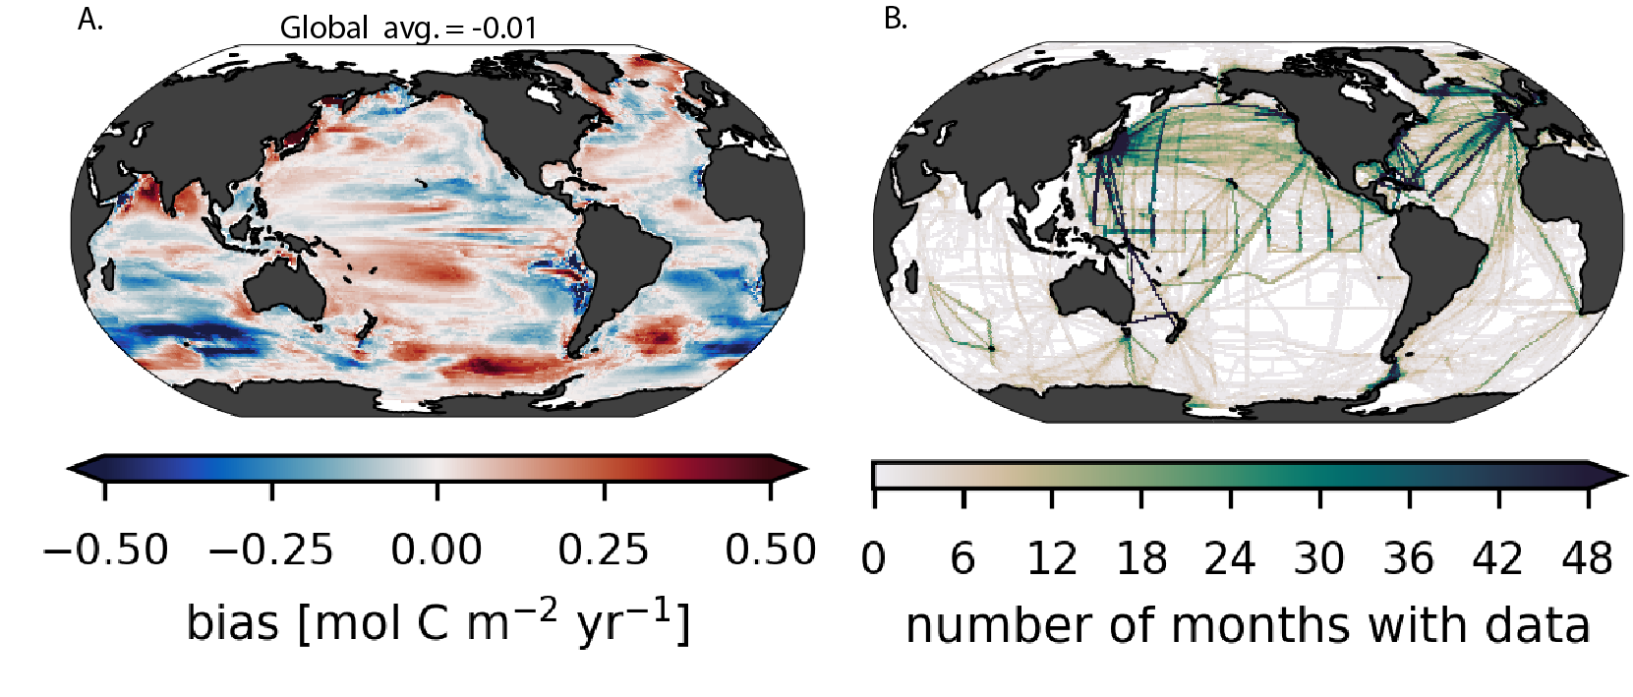
Neural Network bias is small globally, but large where data are most sparse
Global mean bias = -0.01 molC m⁻² yr⁻¹
Mean over 100-members and 1985-2016
Gloege, McKinley et al. in review
16

Slide 17
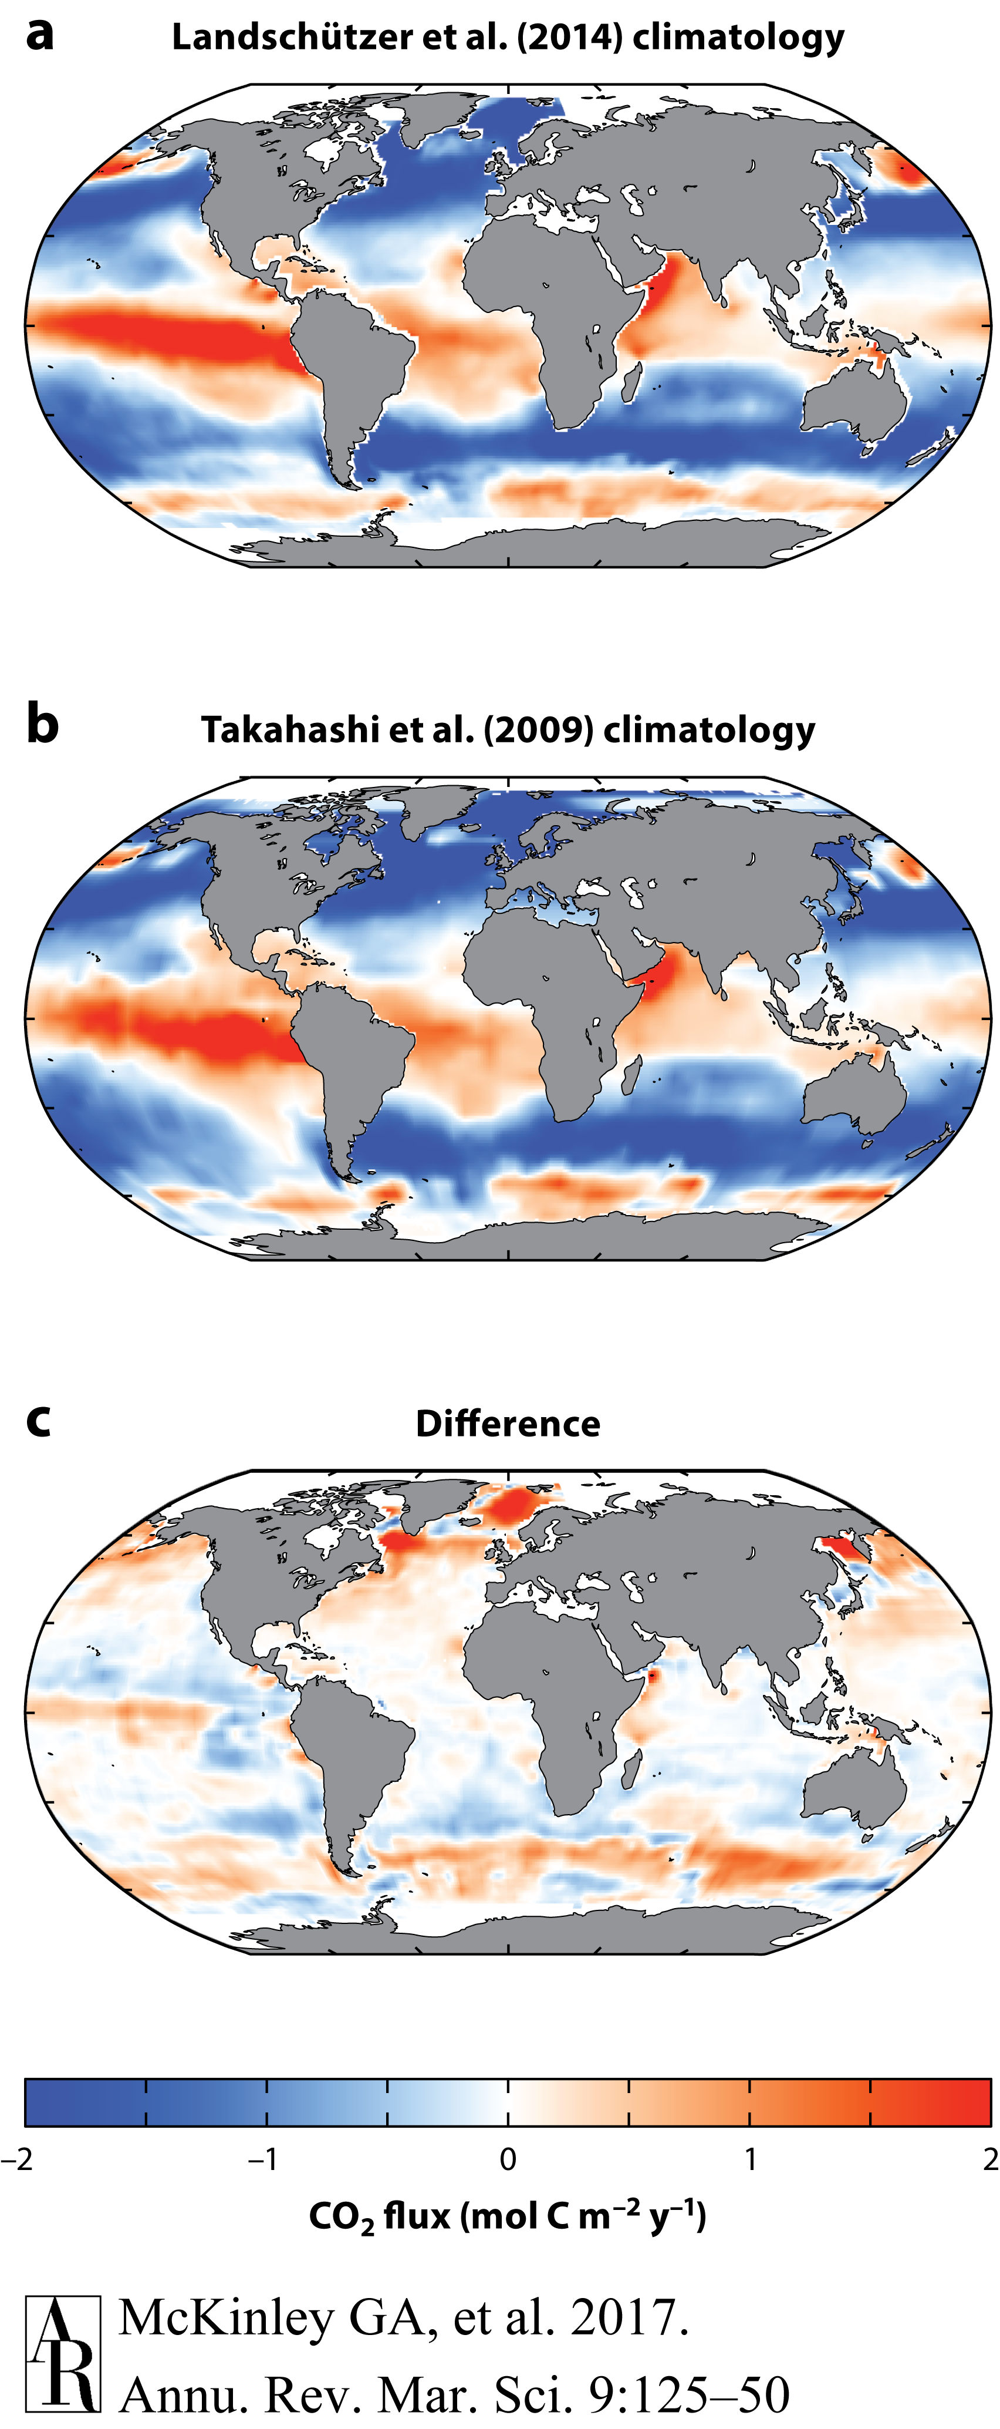
LEAP will develop approaches to quantify and reduce extrapolation uncertainties
ML-based data product
Data product - ESM
Is this difference meaningful given the uncertainty of the ML-based extrapolation?
possible ESM prediction
17

Slide 18
LEAP will push the limits of Machine Learning
More Types
of “Data”
Scalable algorithms for applications of real-world scale
Functional model evaluation for identifying new ML frontiers
Innovative workflows based on ML building blocks
More Physics as Constraints
Uncertainty
Quantification
18

Slide 19
Questions or Feedback?
Galen McKinley, Deputy Director
Tian Zheng, Chief Convergence Officer + Education Director

